Slide 1
Alternate ways to execute Activities People Who Experienced Jesus Year 6 Text book

Slide 2
Lessons
The Saviour is born
The lamb of God who takes away the sins of the world
Jesus who overcame temptations
Jesus who proclaims the good news of the Kingdom of God
Jesus who revealed the glory of God
Jesus who came in search if sinners
Jesus who took our wounds upon Himself
Jesus who died for us
Jesus who taught us forgiveness
Jesus who triumphed over death
The Emmaus Experience
My Lord and My God
The Ascension and the Great Commission
Pentecost and the Proclamation of Faith
Glorified Christ and His Second Coming

Slide 3
Lesson 1 - A saviour is born
Current Activities in Lesson 1 | Alternate ways of Execution
2 - Name three challenges Mary and Joseph faced while they journeyed to Bethlehem and explain why | 2- Teachers are to encourage each table to hold a discussion and think of 2 challenges Mary and Joseph faced while travelling to Bethlehem. Each table is then encouraged to present their findings to the class.
5 - Have a class discussion on how can we give of ourselves to bring joy to others? | 5 - Children are to draw one image on a small piece of paper about how they can bring joy to others - Teacher can create a class poster using all the images at the end.

Slide 4
Lesson 2 - The Lamb of God who takes away the sins of the world
Current Activities in Lesson 2 | Alternate ways of Execution
4 - Teacher and Students sing together Udhana Geetham (Sarvadhipanama Karthave) | 4 - Teacher has the lyrics of the song for the kids to read and sing. Teacher will go line by line and encourage students to guess the english translation of the song , teacher is then to provide the correct translation for the children.
6 - Match the following phrases/sentences used in Baptism with the impacts of Baptism | 6 - Teachers are to print out two sets of the cards seen below. Students are split into two teams and given the separated and shuffled cards. Students will then compete with each other to match the phrases/sentences used in Baptism with the impacts of Baptism. The team which finishes quickly and accurately will be the winners.

Slide 5
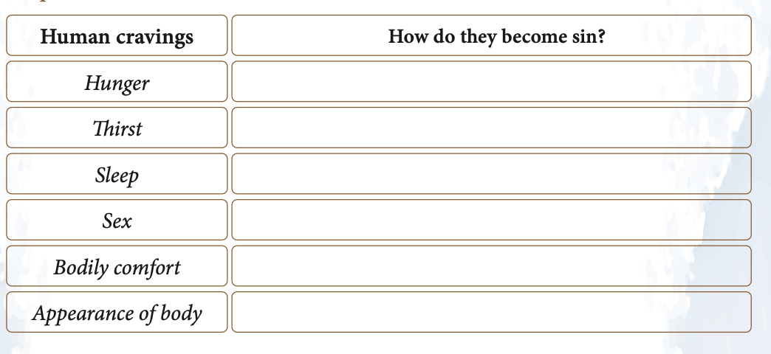
Lesson 3 - Jesus who overcame temptations
Current Activities in Lesson 3 | Alternate ways of Execution
1 - Some human cravings that can become a sin are listed below. Please find out the temptations associated with each that leads us to sin. | 1 - Teacher should have a piece of A3 paper ready with the table seen below drawn on. Students are to have a table discussion on how these temptations can lead us to sin. Students are then to share their answers and teacher will write it down on the paper as well as provide extra clarification.
3 - Write two arguments which prove the passage that we should worship the Lord | 3 - Students are to hold a news conference where they sit in a circle and discuss arguments on why we should worship the Lord. The teacher can be the news presenter and ask thought provoking questions to the children.

Slide 6
Lesson 4 - Jesus who proclaims the good news of the Kingdom of God
Current Activities in Lesson 4 | Alternate way to execute
1 - Children are to create a cartoon strip of the 5 main points of Jesus’s proclamation. | 1 - Each child is provided with 5 small pieces of paper the size of a post-it note , children are then free to draw their own images. Students are then encouraged to attach their cartoon to a larger class poster containing all the mini cartoon pictures.

Slide 7
Lesson 5 - Jesus who revealed the glory of God
Current Activities in Lesson 5 | Alternate ways of Execution
2 - Find out how you can do a simple, yet lofty deed that glorifies God. It should aim to meet a need of a person/church; it should be an act of self-giving: that means giving up your time, money or comfort. It should be an act that brings joy to another’s life. Write your answer here and explain how it glorifies God. | 2 - Draw an activity of self-giving. An act that brings joy to another’s life. Draw the act and each student takes a turn to explain to the class what they drew and tell them how it glorifies God. Compile these drawings into a class poster.
4 - Teacher to share a miracle that occurred at either a retreat centre, place where the Word of God is preached or through a saint’s intercession. | 4 - Teacher to compile online testimonies of the faithful sharing miracles they experienced from God. Providing online testimonies will be more interesting and easier to comprehend for children.

Slide 8
Lesson 6 - Jesus who came in search of sinners
Current Activity in Lesson 6 | Alternate way of Execution
2 - Teacher to lead the discussion and let students share their responses about their understanding of the Prodigal Son parable. | 2 - Each student is to receive a piece of paper where they can write their own understanding of the Prodigal Son parable. Teacher can then collect these responses and correct any incorrect assumptions.

Slide 9
Lesson 7 - Jesus who took our wounds upon Himself
Current Activities in Lesson 7 | Alternate ways of Execution
1 - Jesus is my Super Hero - Write down the strengths that you see in Jesus and why you like Him the most? | 2 - Students are provided with craft materials and a piece of paper. Students are then instructed to draw Jesus as their Superhero as well as Jesus’s superpowers e.g. protection from evil , guidance , forgiveness , everlasting love
3 - Read, reflect and write - “What reason would make Jesus suffer all this , when He had the power to make it all stop?” | 2 - Students are to write their responses on a piece of paper. Students are then to pass around their responses so that they can read what their peers wrote and view other perspectives.

Slide 10
Lesson 8 - Jesus who died for us
Current Activities in Lesson 8 | Alternate ways of Execution
2 - Write an acrostic poem (each letter of the word is the first letter of another word) using the letters in the word CROSS | 2 - Each table group will receive an A3 piece of paper to create their acrostic poem. Students are to decorate their poems with pictures depicting events that occurred during the Passion of Christ.
3 - Paraphrase in three sentences the meaning of Jesus’ death on the Cross from the Parish priest’s answer. | 3 - Discuss the activity as a table group and share your findings to the class.

Slide 11
Lesson 9 - Jesus who taught us forgiveness
Current Activities in Lesson 9 | Alternate ways of Execution
1 - Discuss in the class the amazing effect of Jesus’ forgiveness prayer in the lives of: The Roman centurion at the foot of the cross One of the two thieves crucified with Jesus Three thousand people in Jerusalem For all those who would ever believe in Him, and for me personally | 1 - Children are to be split into table groups and allocated one of the groups. Children are then to present a short news interview where they discuss how their lives have changed. Some children will be the news presenters asking questions and others will be the characters answering questions.
3 - Let the class sing together the Anna Pesaha song and discuss how it is connected to Mt 5:24. | 3 - Teacher has the lyrics of the song for the kids to read and sing. Teacher will go line by line and encourage students to guess the english translation of the song , teacher is then to provide the correct translation for the children.

Slide 12
Lesson 10 - Jesus who triumphed over death
Current Activities in Lesson 10 | Alternate ways of Execution
3 - Write the meaning of symbols below | 3 - Teacher should have this symbol printed out on a A3 piece of paper. After a brief discussion , children are to write their personalised explanations of the symbols on the class paper.
4 - From the table below, pair which sacrament is alluded to each post resurrection command of Jesus Christ. | 4 - Print the table out onto A4 paper and split the class into table groups. Ask the children to work together to discuss and fill in the table together. See which table group can finish the fastest.

Slide 13
Lesson 11 - The Emmaus Experience
Current Activities in Lesson 11 | Alternate ways of Execution
The purpose of this activity is for teachers to lead children to physically experience the Emmaus Walk that is depicted in the Bible. Find an area outside where the teacher and class can go for a walk and complete this activity. Teacher is to have a printed version of the bible passage Luke 24: 13-35 detailing the Emmaus walk. Teacher is to read a few lines of the bible passage and then walk 50m with the class. A student will then be chosen and they will read a few lines of the passage and then walk for another 50m as a class. This pattern will repeat until the Bible passage has been read completely. OPTIONAL - Students are provided with a buddy and allowed to walk around and reflect on the Emmaus walk with their buddy for 3 minutes before going back to class.

Slide 14
Lesson 12 - My Lord and my God
Current Activity in Lesson 12 | Alternate way of Execution
2 - Write down your reflective answer | 2 - Print a picture of St Thomas printed on A2 paper and in different coloured pens write the answers of the question around the picture of St Thomas. St Thomas became an exceptional witness of resurrection because (red pen) Write down the profession of faith of St. Thomas the Apostle (blue pen) To worship means to put Lord at the centre of our lives. How did St/ Thomas put the Lord at the centre of his life (black pen) What name are the Indian Christians of St. Thomas the Apostolic origin called by? (green pen)

Slide 15
Lesson 13 - The Ascension and the great commision
Current Activity in Lesson 13 | Alternate way of Execution
2 - Let us read together the Great Commission narrative (Acts 1:6-8; Mt 28:16-20) and tick your answer, when you have reflected on the reading. | 2 - Teacher is to split the classroom into a ‘true’ side and a ‘false’ side , students are to stand in the middle of the classroom. Teacher is to read out the questions and students are to move to either the ‘true’ or ‘false’ side of the classroom.

Slide 16
Lesson 14 - Pentecost and the Proclamation of Faith
Current Activities in Lesson 14 | Alternate ways of Execution
2 - Find the contrast of the events narrated and explore the deeper meanings of Pentecost | 2 - Split children into table groups and allocate a different question to each group.
3 - Discuss the description with the right column in your class and find the name of the “gift” of the Holy Spirit. A hint of the name is given as its first letter! | 3 - Print out this activity and split the children into groups. Children are to find the Gift of the Holy Spirit and also draw examples of these gifts on their poster.

Slide 17
Lesson 15 - Glorified Christ and His Second Coming
Current Activities in Lesson 15 | Alternate ways of Execution
3 - Write down how we can purify these human acts in view of the love of God and the love of our fellow beings. In what way could we spice them up to make them more worthy? | 2 - Print out the different words and place onto the board. Ask students to come up and answer the question of “How can we purify these human acts to view the love of God and others.
4 - Let us analyse the signs of The Second Coming to understand that we are living in an extended period of the final age. Let’s look at these three areas, discuss your ideas in groups and write down your findings. | 4 - Teacher has this activity printed out on a A2 paper. Students are to have a quick table discussion and then provide answers to teacher who will encourage them to write their answers on the board. Teacher can ask students to recite a quick prayer for those affected by the natural disasters, wars and religious persecution.

Slide 18
SUGGESTION - Class party + Showcase
Final lesson of the year can be an exhibition displaying all the creative pieces that the children have created over the year. Children should be encouraged to bring in a plate to share with their classmates !

Slide 19
THANK YOU
Prepared by: Anna Biju and Shefin Shaji St. Alphonsa Forane Parish Parramatta
Reviewed by: Department of Catechesis, Syro- Malabar Eparchy of Melbourne

